Slide 1

DBMS PROJECT
ONLINE SHOPPING SYSTEM
Submitted By –
Divy Bansal
Lavish Nagar

Slide 2
Project Description
This project is designed to serve as a platform for sellers and customers to Sell/Buy Items.
Customers can place orders of the items that are listed on the platform by various sellers
Customers can choose items and add them to cart before placing orders.

Slide 3
Sellers can add items for sale on the platform.
Sellers can update the status of the order placed by customer
Customers Can Track The Status Of Previous Orders Placed

Slide 4
Tools/Platform Used
Front End
HTML
CSS (BOOTSTRAP)
Back End
PhP
MySQL DATABSE

Slide 5
Modules in Project
Admin Login :
Admin can login and manage the sellers and customers registered on the platform.
Admin Can See Which Products Are Sold By which Seller
Admin Can See The History Of All Orders Placed Through The Site.

Slide 6
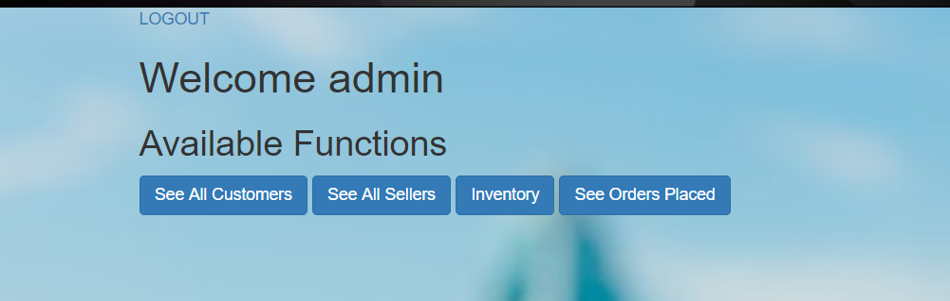
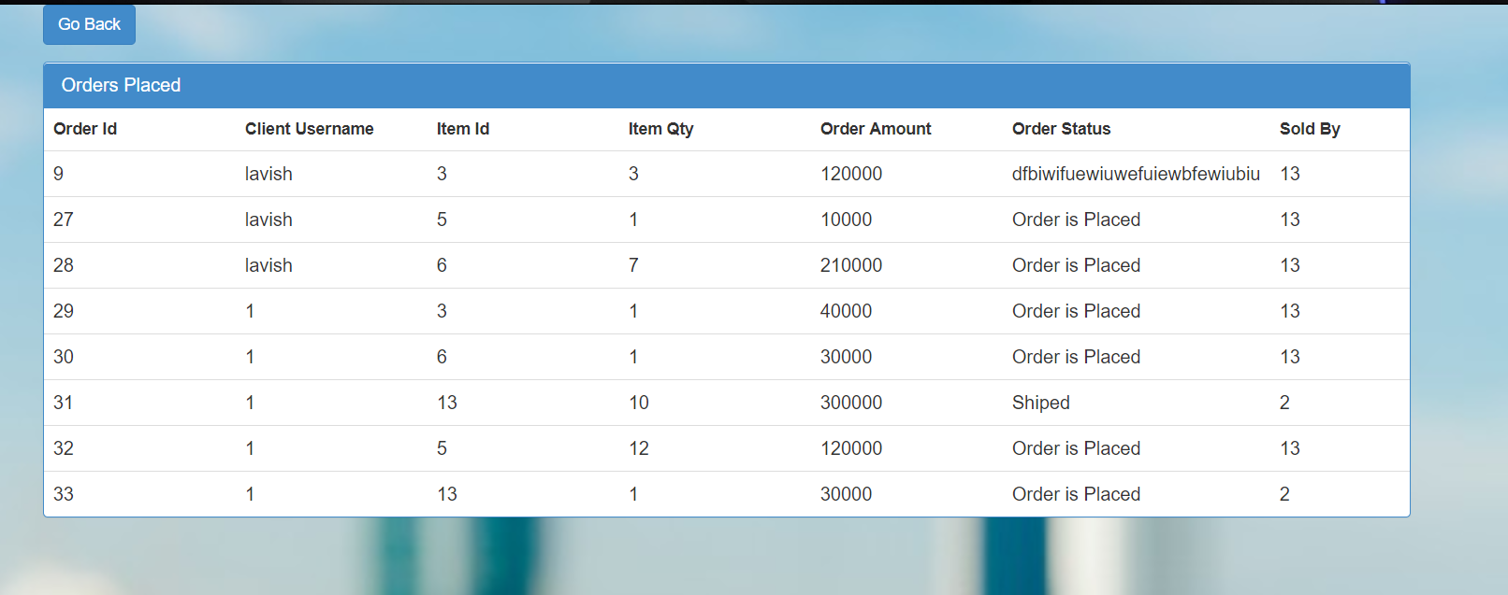

Slide 7
Seller Login :
A New Seller Can Sign/Up And Register On The Site
After Registration Seller Can Login
Seller Can Add Different Items He Want To Sell On The Platform
Seller Can Also View The Orders That Are Placed
Seller Can Update The Customer About The Status Of The Orders

Slide 8
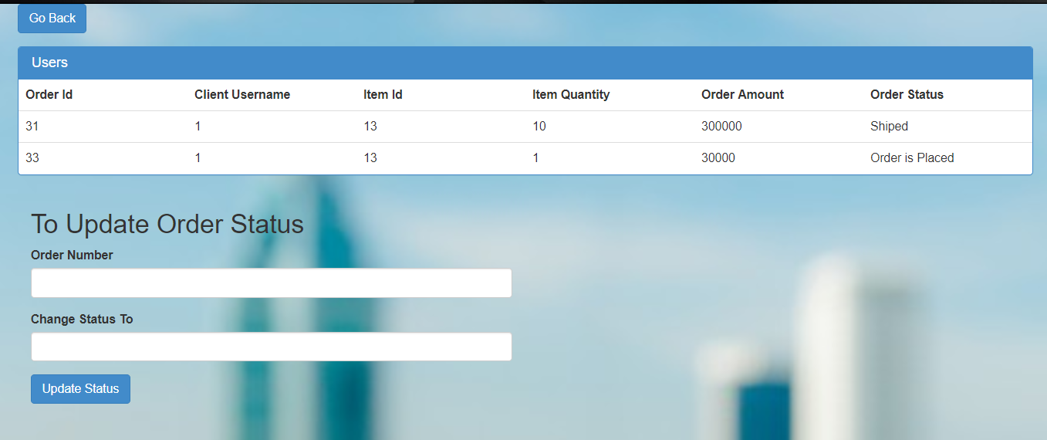

Slide 9
Customer Login :
A New Customer Can Sign-Up And Register On The Site
After Registration Customer Can Login On The Platform
Customer Can See Different Items Available On The Platform for Buying
Customer Can Add The Items To Cart For Future Use

Slide 10
Customer Can See Items He Want To Buy In Cart And Add/Remove Item
Customer Can Place Order From The Cart
Customer Can See Previous Orders Placed By Him and Track Status Of Orders Placed

Slide 11
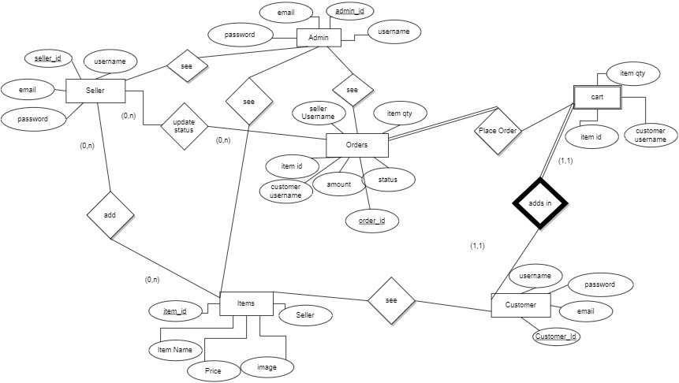
ER DIAGRAM

Slide 12
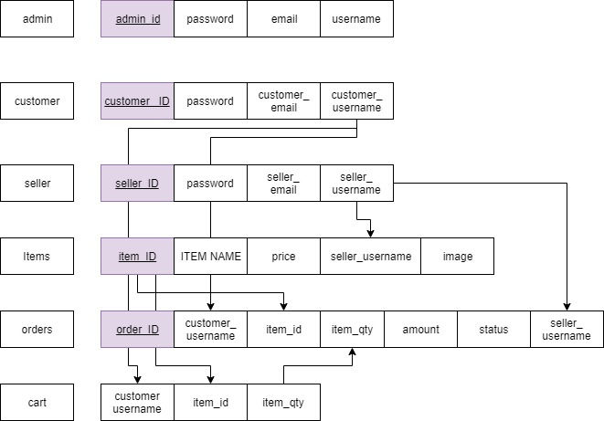
SCHEMA

Slide 13
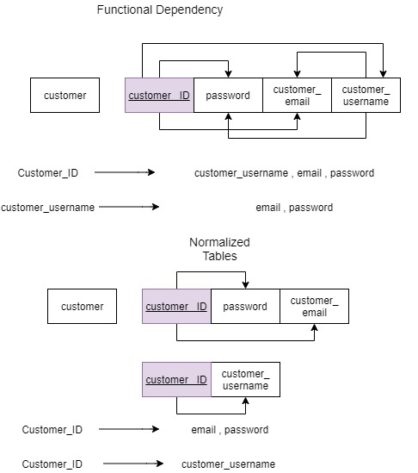
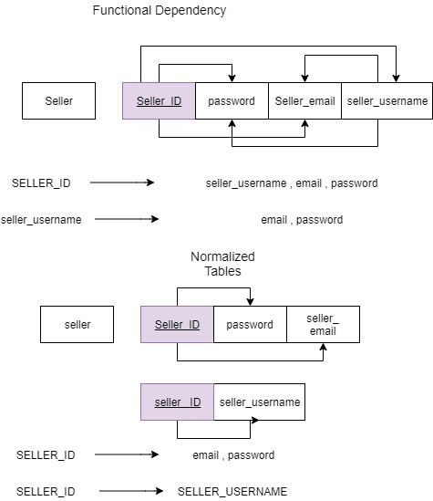

Slide 14
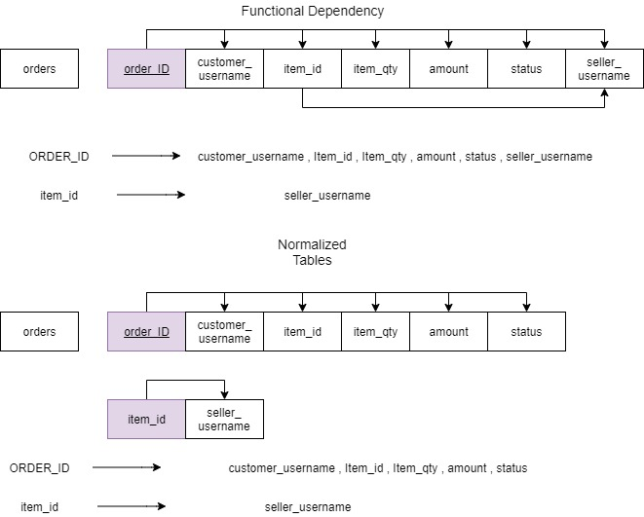

Slide 15
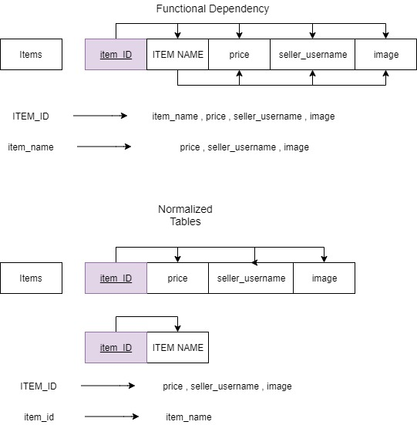

Slide 16
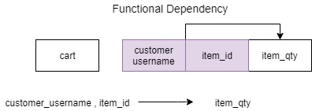

Slide 17
REFERENCES
Some Of The Websites Referred During The Development of The Project
W3SCHOOLS
STACK OVERFLOW
MATERIALIZE CSS
Google Images
WikiPedia

Slide 18
Thank You

